Slide 1
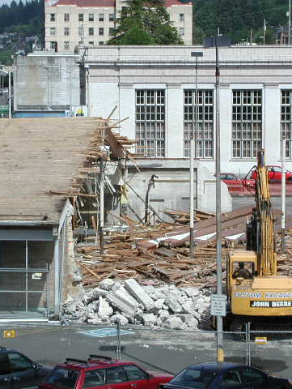
Clatsop County Brownfield Assessment & Clean-Up Info Session
Tuesday, November 7th
Clatsop County & Columbia Pacific Economic Development District

Slide 2
Agenda
Welcome and Introductions
Intro to Brownfields
Updates on Clatsop Assessment Program
Update from Clatsop Housing Task Force Q&A
Brownfield Clean-up Resources Q&A

Slide 3
What is a Brownfield?
“…A Brownfield site is defined as real property, the expansion, redevelopment, or reuse of which may be complicated by the presence or potential presence of hazardous substances, pollutants, contaminants, controlled substances, petroleum or petroleum products, or is mine-scarred land.”

Slide 4
Regional Brownfield Approach
Spring 2021:
Business Oregon Interim Planning Grant (IPG) Awarded to ColPac for public outreach, site selection and EPA grant Applicator Development
Fall 2021:
ColPac applied for EPA Brownfield RLF --$1,000,000
Tillamook County applied for an EPA Community-wide Brownfield Assessment Grant --$500,000
Clatsop County applied for an EPA Community-wide Brownfield Assessment Grant --$500,000
ColPac’s Business Oregon IPG yielded $2,000,000 NW Oregon

Slide 5
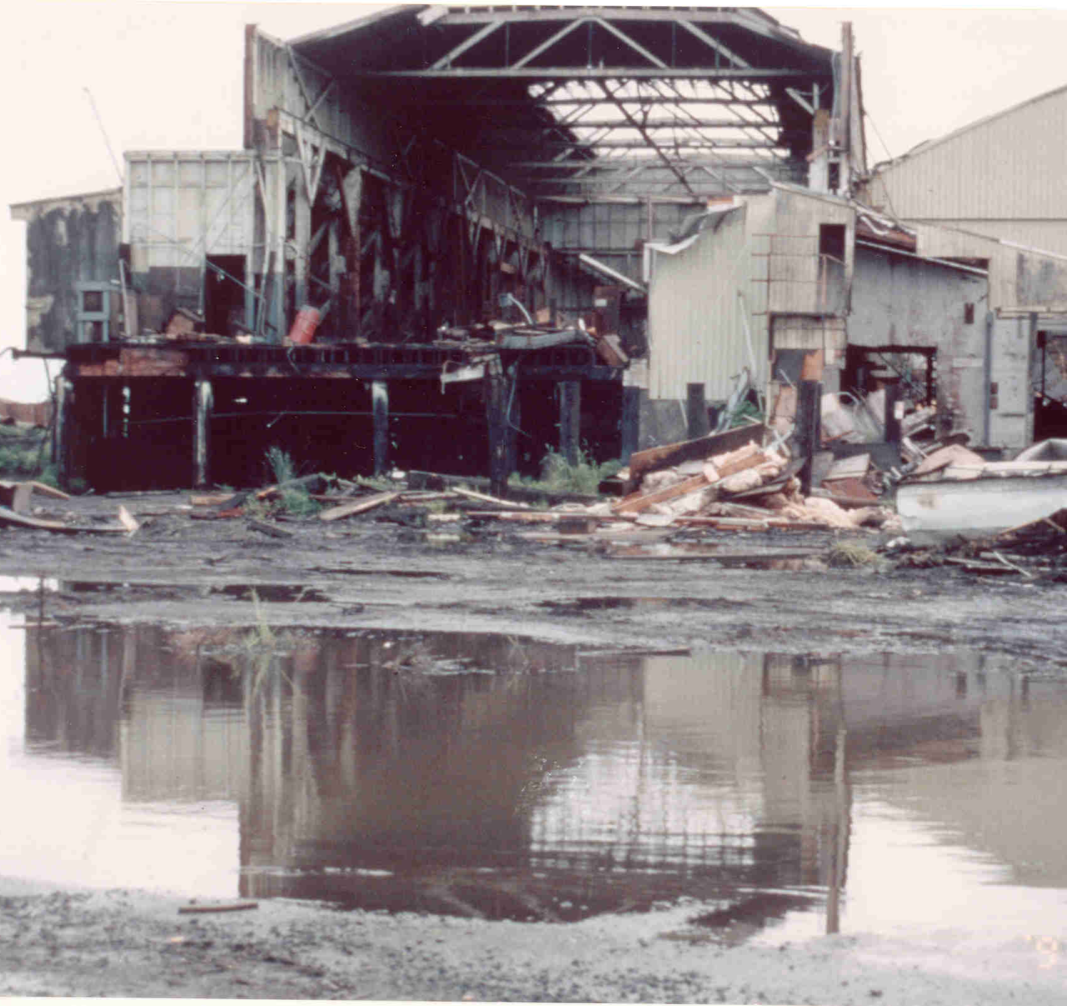
Clatsop County Assessment Program
Bulk of Funding: Environmental Assessments
Identify and prioritize brownfields
Community Engagement
Cleanup/re-use planning

Slide 6
Environmental Assessments
Phase I ESAs
Desktop study
Historical uses
Property transactions
Phase II ESAs
Environmental sampling
Soil, water, soil gas
Asbestos, lead paint

Slide 7
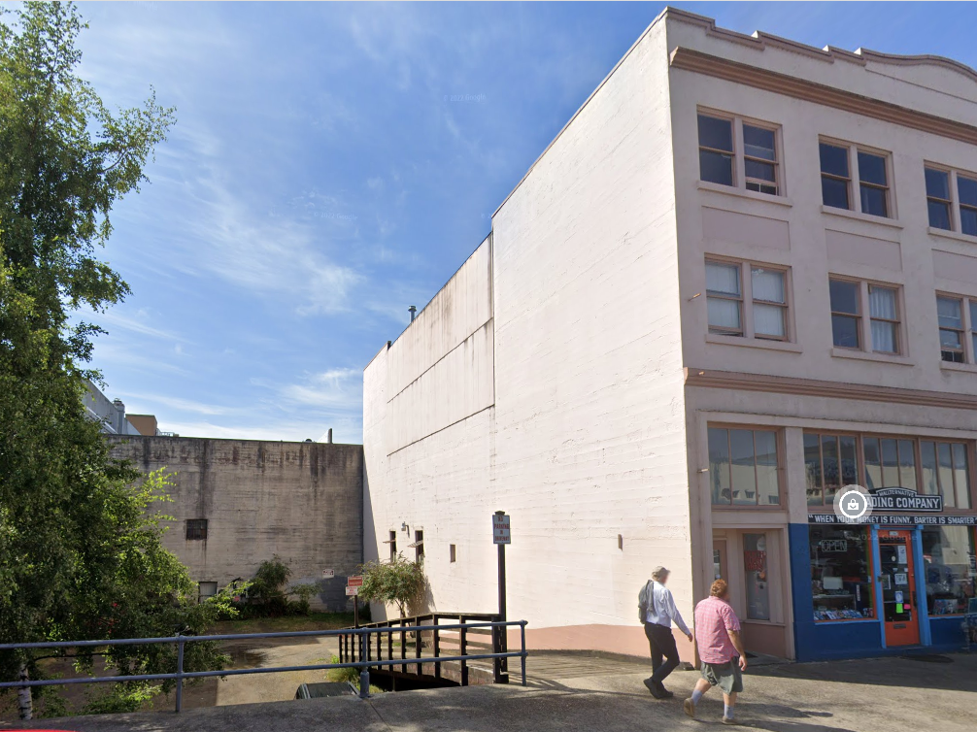
Copeland Commons 1167 Marine Drive Astoria, OR
Notes:
Owned by local nonprofit, plans for affordable housing

Slide 8
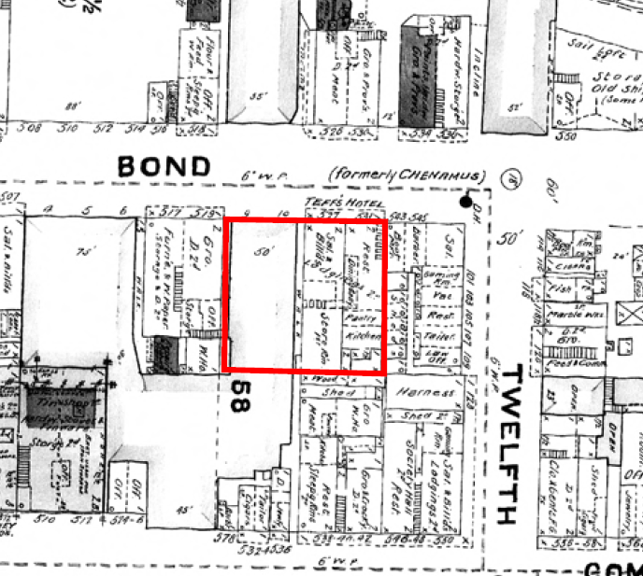
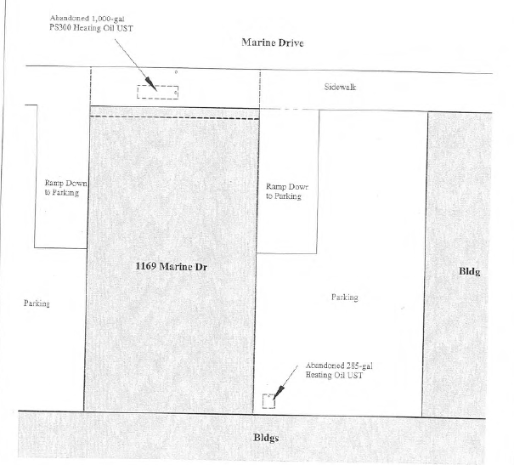
Copeland Commons
Historical uses: hotel and storefronts
2 Heating Oil Tanks decommissioned

Slide 9
Copeland Commons
Lead paint and asbestos survey
No asbestos detected
Trace lead in paint
Soil, groundwater, soil/sub-slab gas sampling
Low level petroleum detections (urban soil)
Above clean fill standard
No active cleanup needed
Manage soil during construction

Slide 10
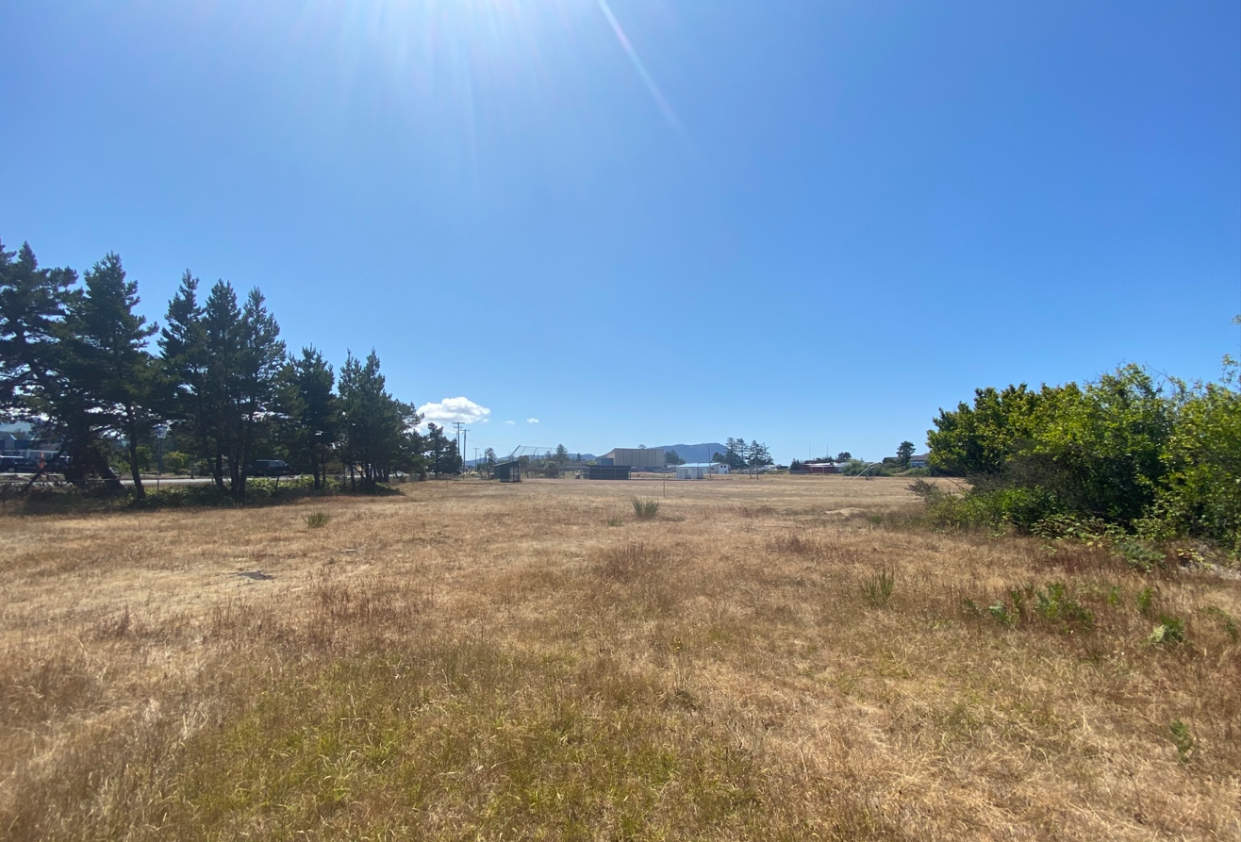
“North North 40” Site 989 Broadway, Seaside, OR
Notes:
Owned by City of Seaside – plans for affordable housing

Slide 11
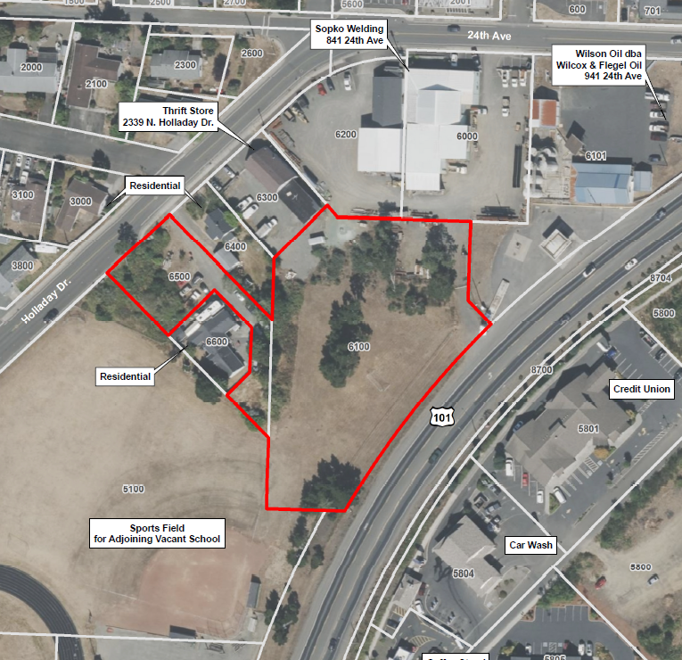
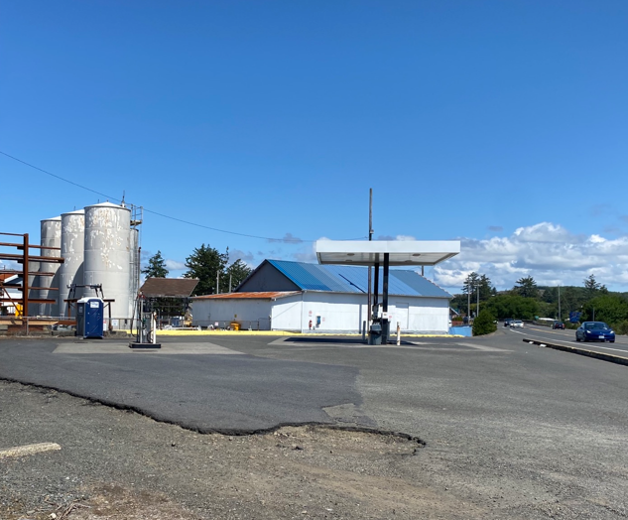
“North North 40” Site
Phase I and II ESAs
Adjacent bulk fuel storage/distribution
Field work completed

Slide 12
“North North 40” Site
Soil, groundwater, soil gas sampling
Lab reports rolling in . . .

Slide 13
Clatsop County Housing Task Force

Slide 14
ColPac’s Brownfield Revolving Loan Fund

